Slide 1
Raspberry Pi STL format Recognition
Shams Torabnia, Hammad, ShokHrat

Slide 2
Product Maturity
Conceptual Design
Brain Storming
Benchmarking
Design
Modules
Test and Improvement
Maturity
Product definitions
Functions
Goals
Platforms
Tools
Main Framework
Diagnostics
Beta Test

Slide 3





This Photo by Unknown Author is licensed under CC BY-SA-NC

Slide 4
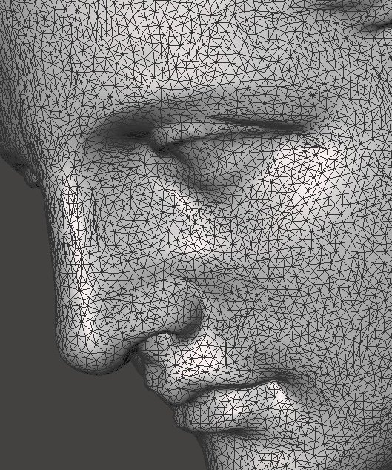
3D Topology
Node1 (x1,y1,z1)
Normal Vector (Vx,Vy,Vz)
Node2 (x2,y2,z2)
Node3 (x3,y3,z3)

Slide 5
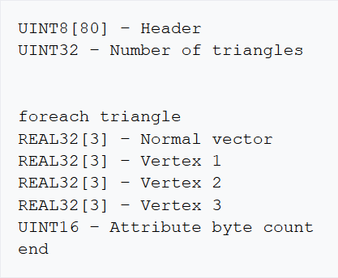
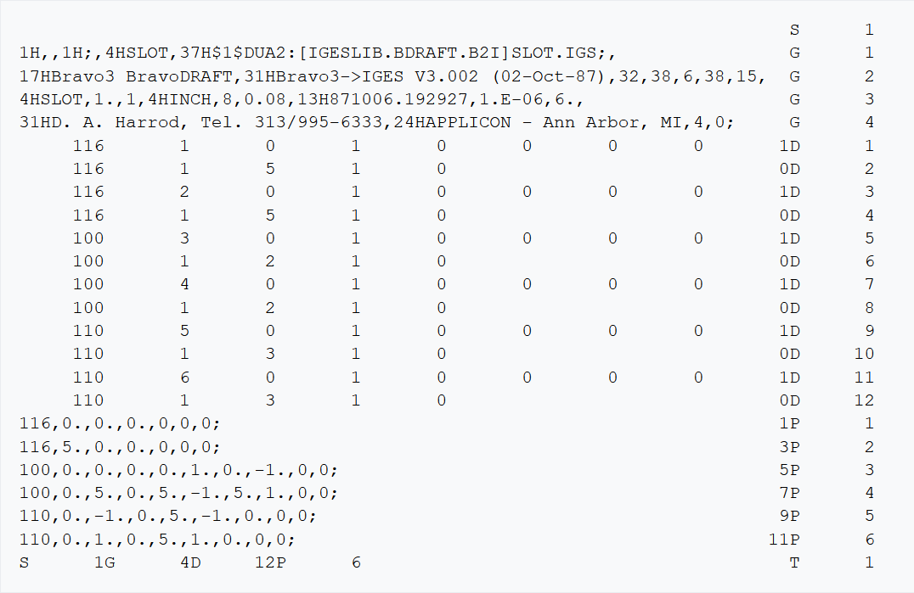
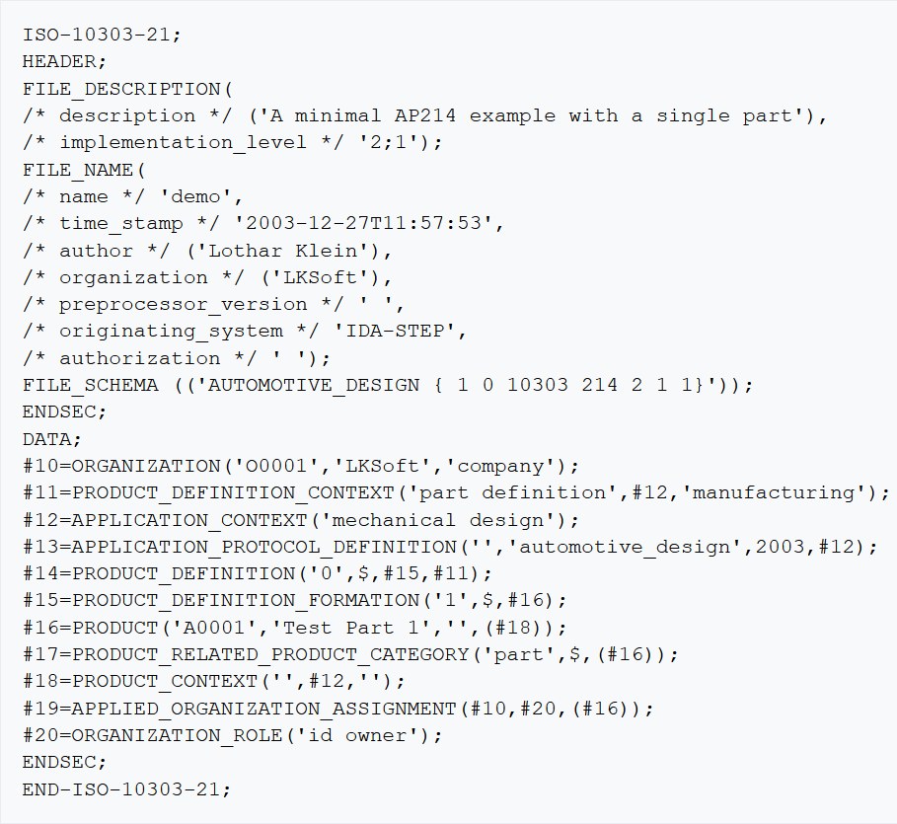

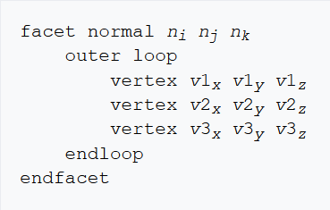





File types
STEP
STL
IGS
ISO-10303-21
3MF

Slide 6
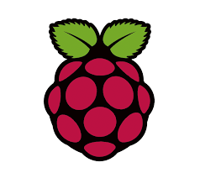
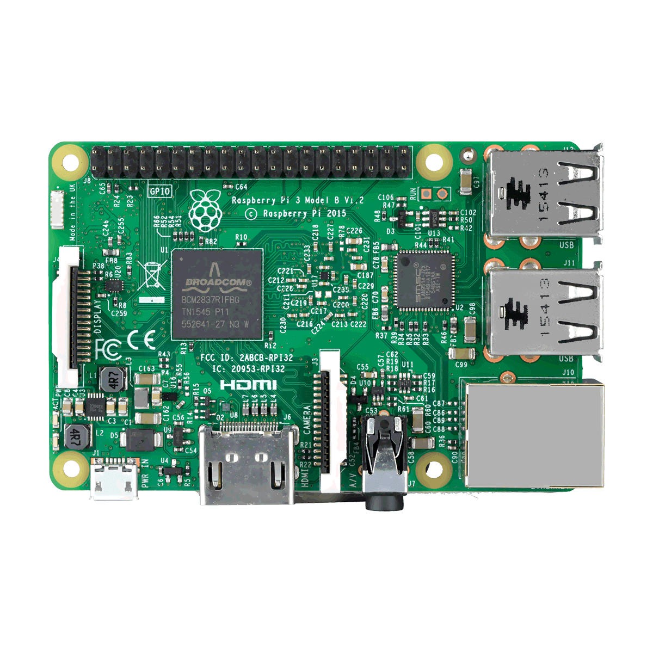
Raspberry Pi
Processor: Quad-core Cortex-A72 (ARM v8) 64-bit SoC @ 1.5 GHz
Memory: Accesses up to 4GB LPDDR4-2400 SDRAM
Caches: 32 KB data + 48 KB instruction L1 cache per core. 1MB L2 cache.
Multimedia: H.265 (4Kp60 decode); H.264 (1080p60 decode, 1080p30 encode); OpenGL ES, 3.0 graphics
I/O: PCIe bus, onboard Ethernet port, 2 × DSI ports (only one exposed on Raspberry Pi 4B), 2 × CSI ports (only one exposed on Raspberry Pi 4B), up to 6 × I2C, up to 6 × UART (muxed with I2C), up to 6 × SPI (only five exposed on Raspberry Pi 4B), dual HDMI video output, composite video output.

Slide 7
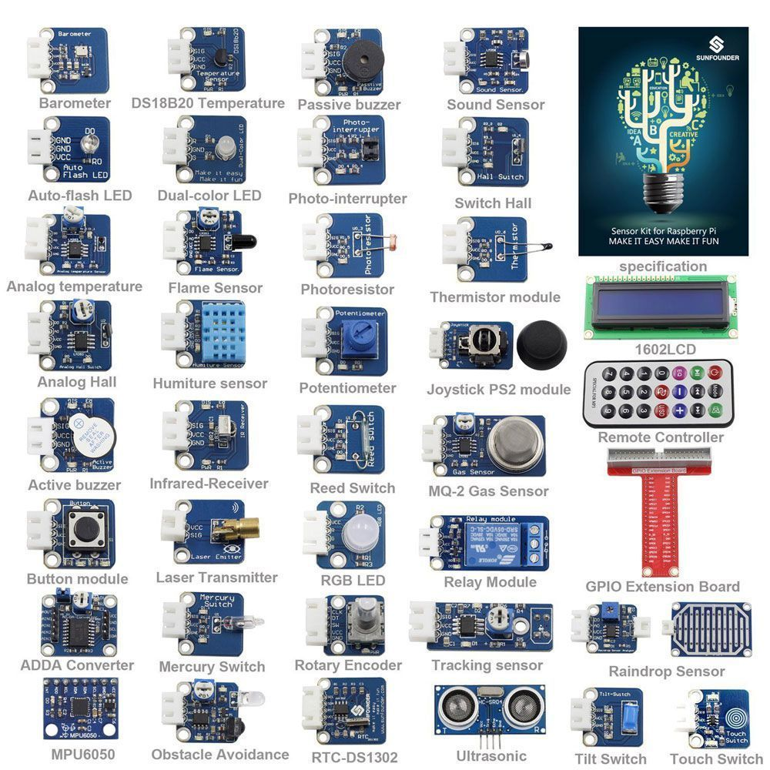
Sensors

Slide 8
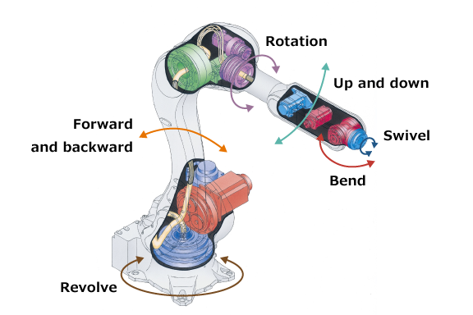
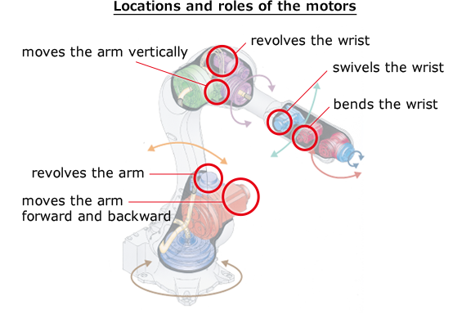
Actuators

Slide 9
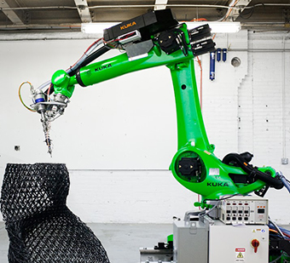
Robotic 3D printing

Slide 10
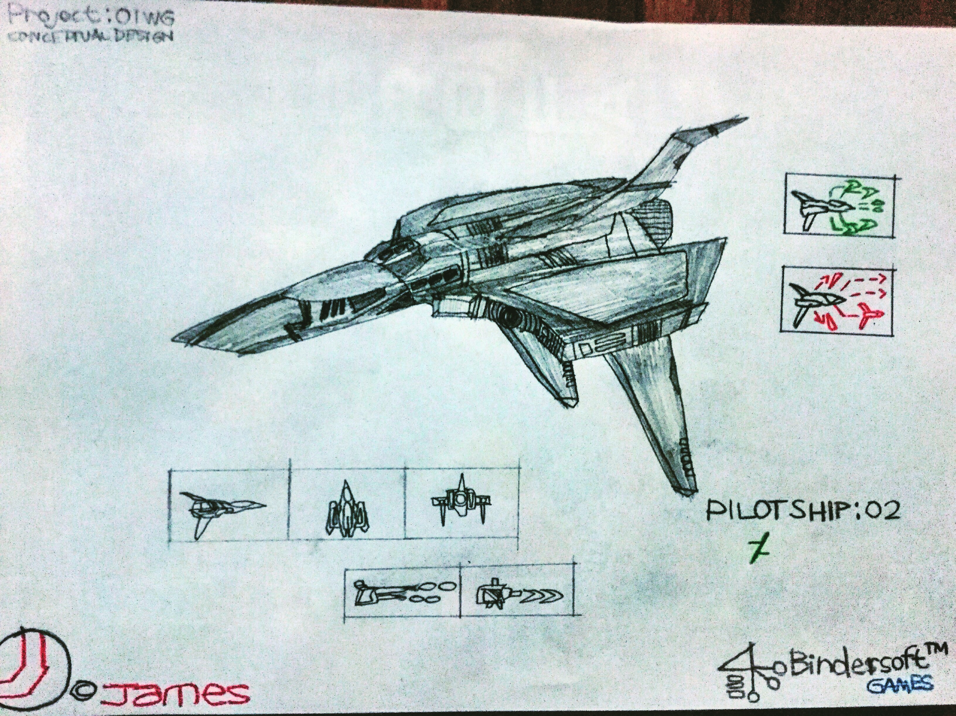
This Photo by Unknown Author is licensed under CC BY-SA

Slide 11
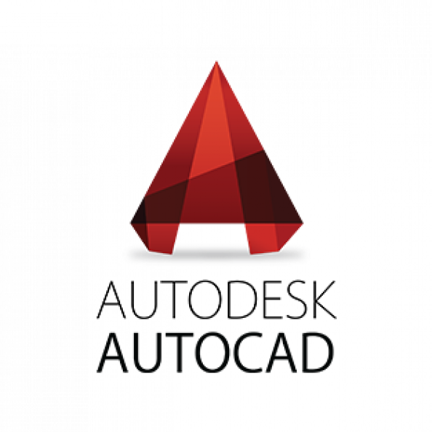








CAD
Computer Aided Design

Slide 12
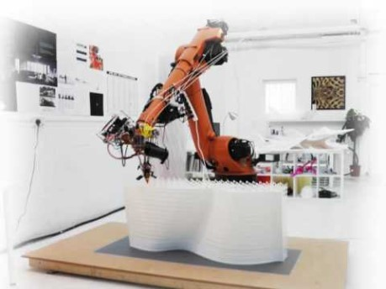
Project Main Objective
Design a software which could recognize STL filetypes in Raspberry Pi for the purpose of robotic 3D printing.

Slide 13


RaspiSnakes CAD

Slide 14

Design(Development)

Slide 15
Main Platform (VER 0.00)
Plotter
General Toolbox
Create Toolbox
RasP.STL (Page File)
User Entry

Slide 16
Main Algorithm

Slide 17




Modules
numpy-stl
math

Slide 18
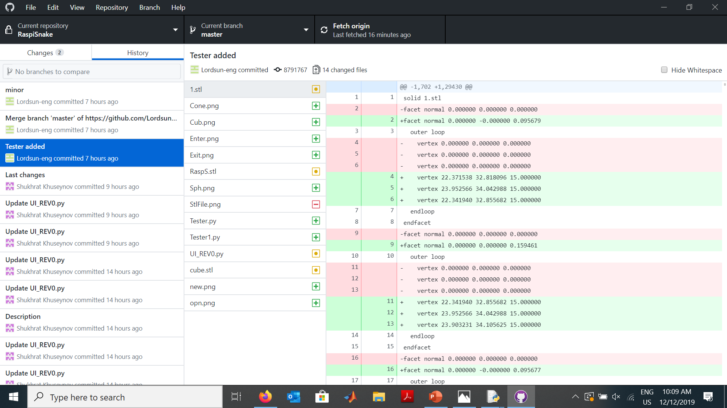

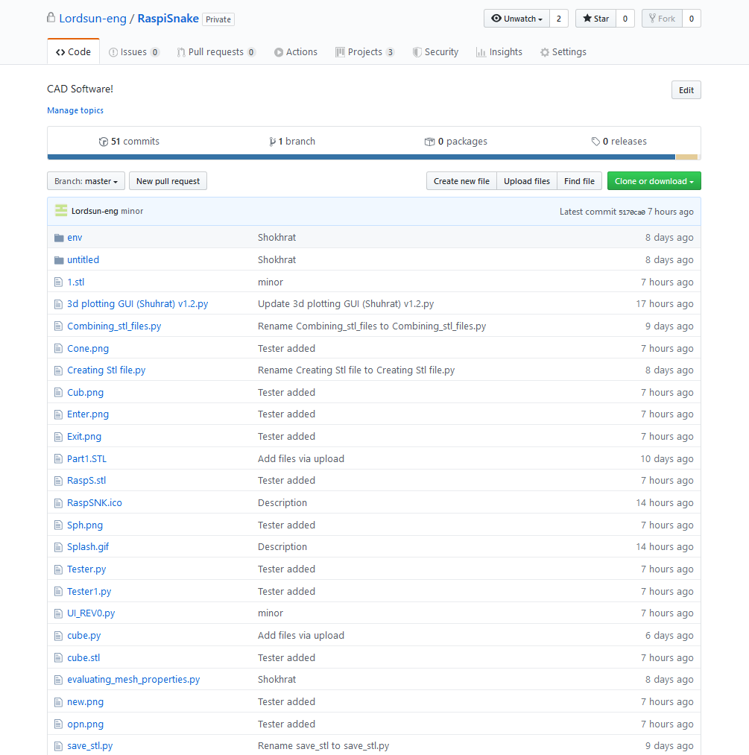
GitHub

Slide 19
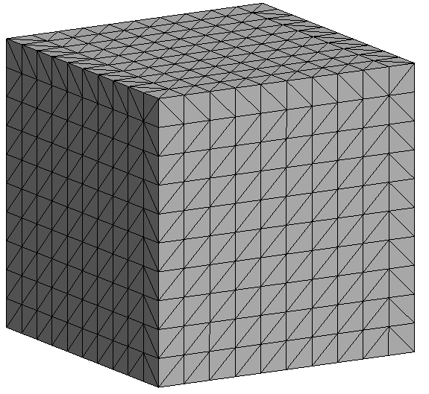
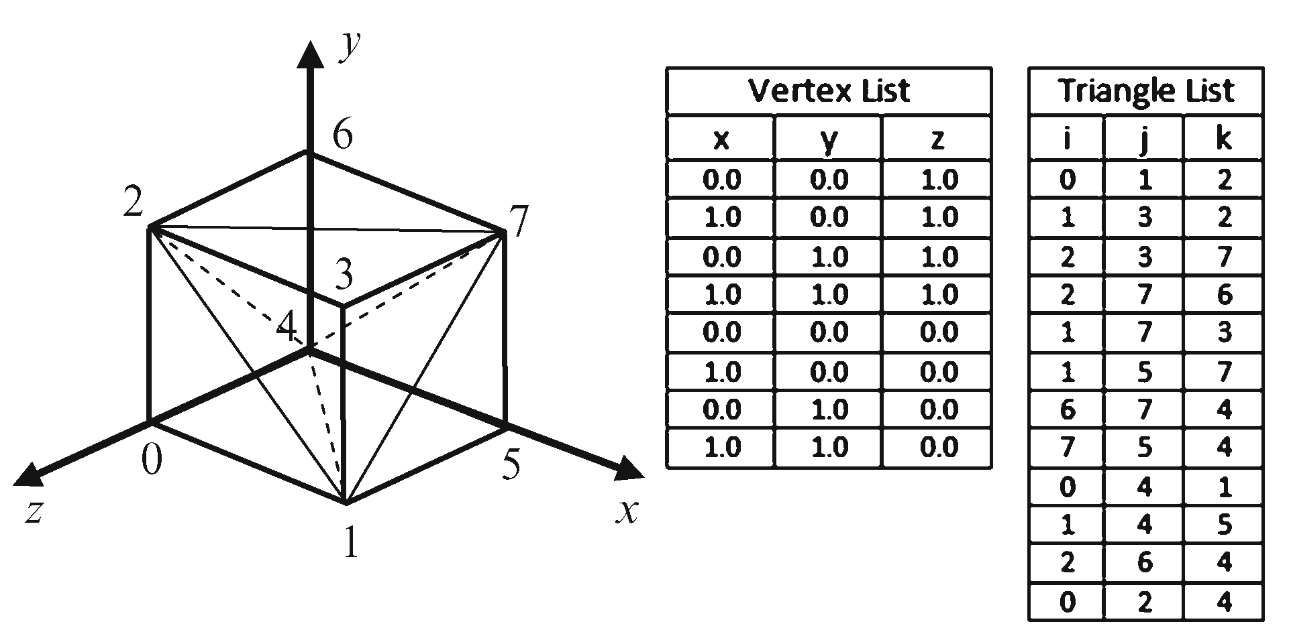
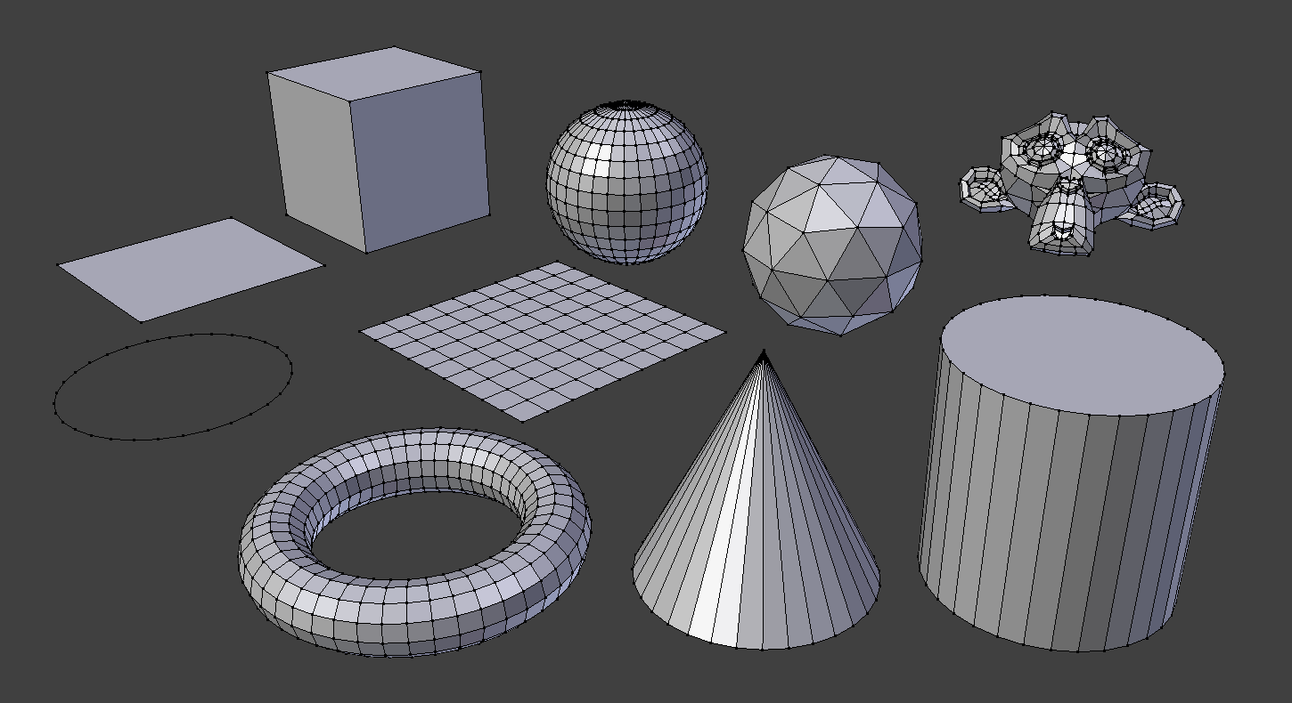
Function

Slide 20
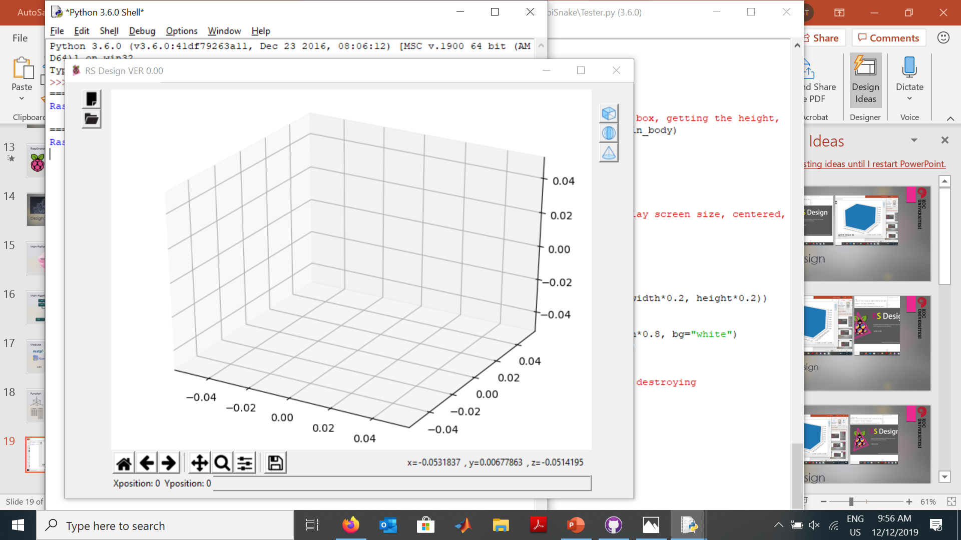
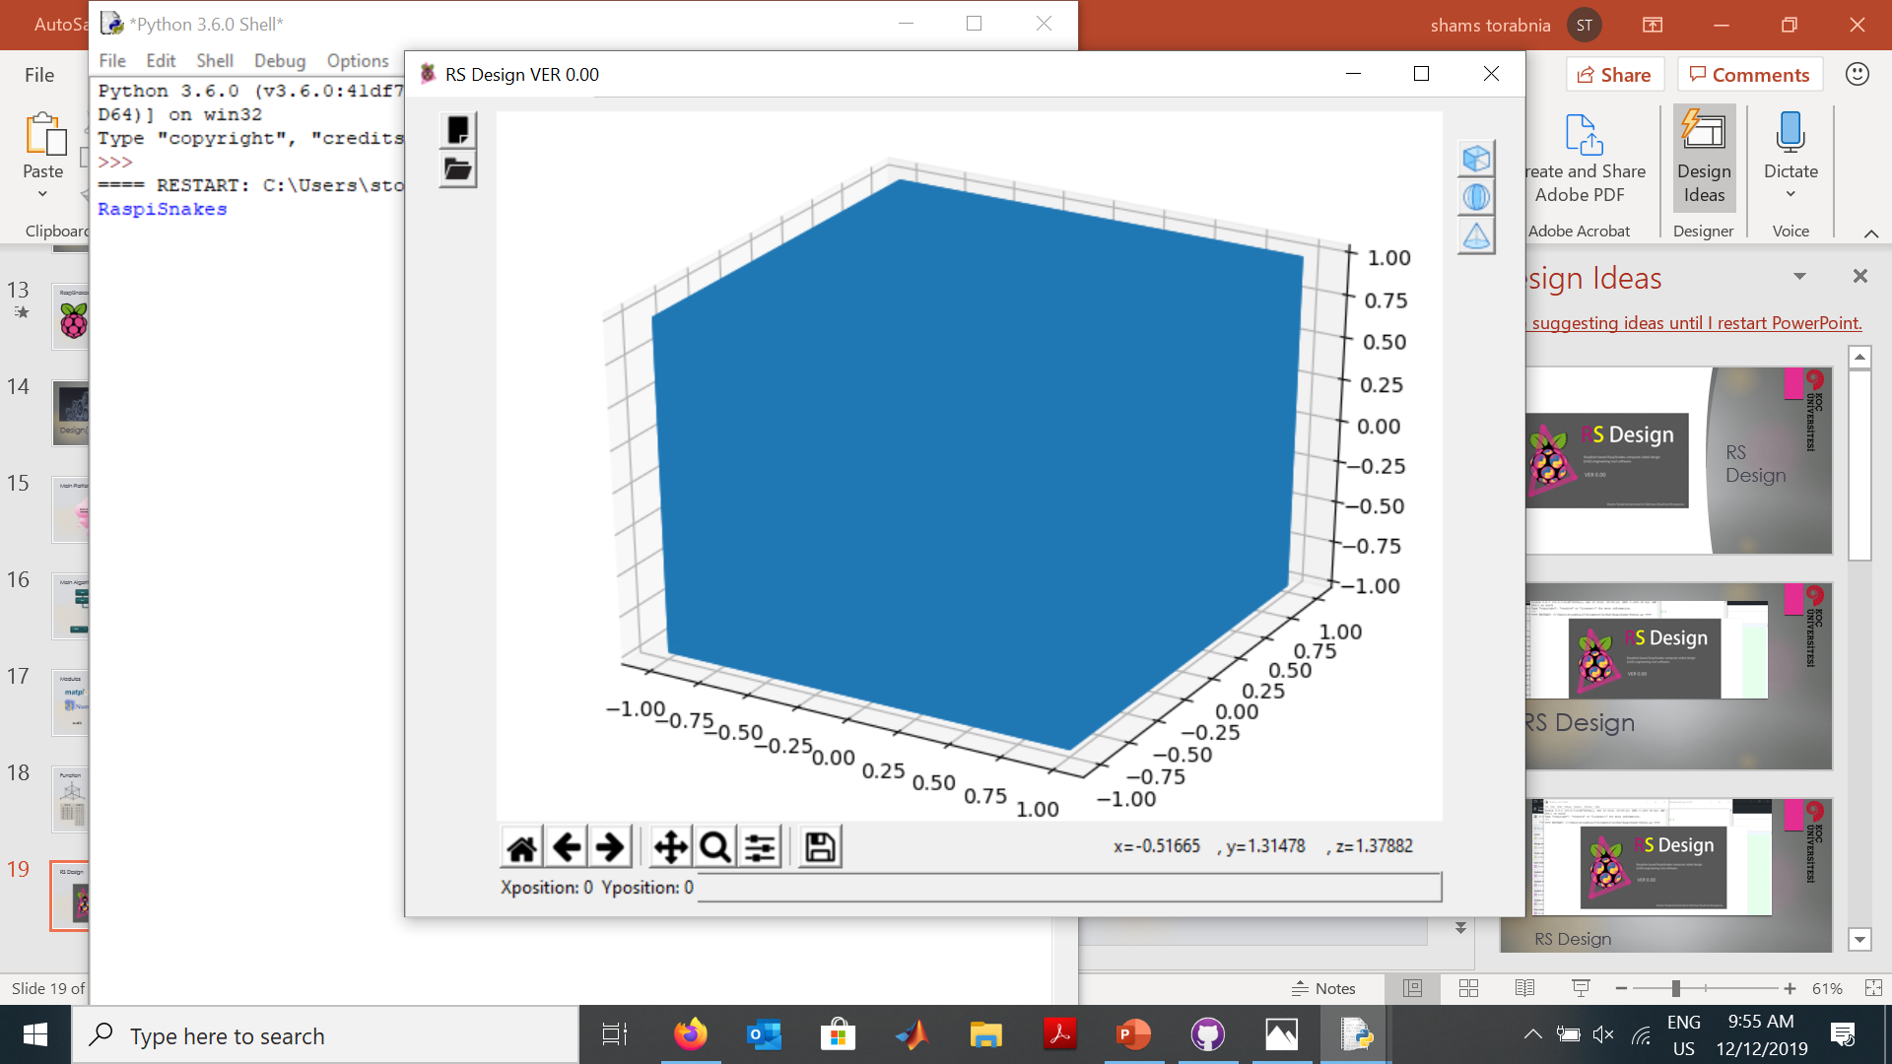
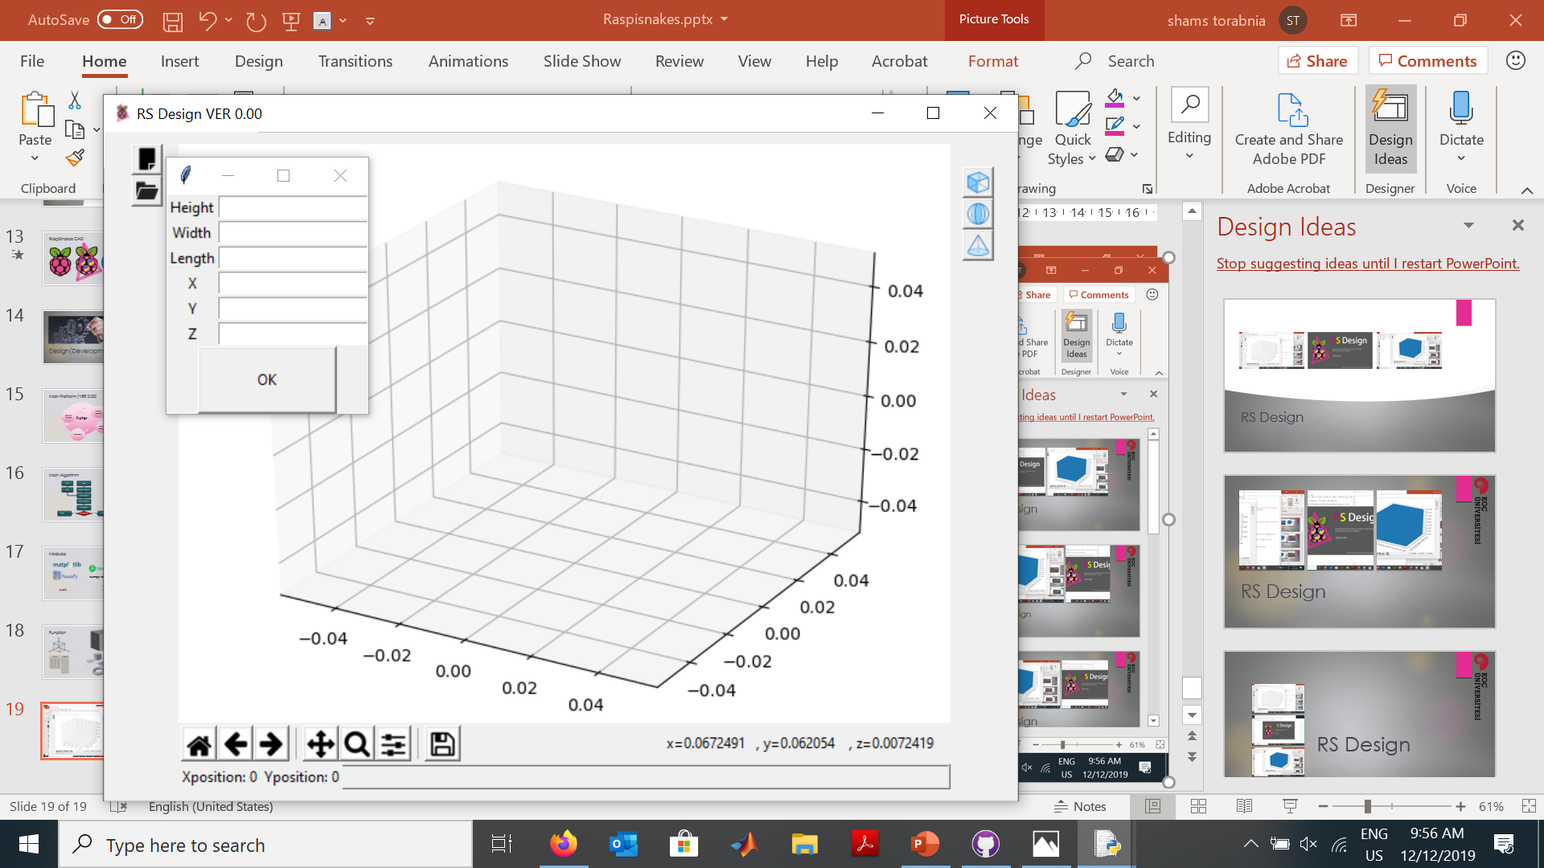
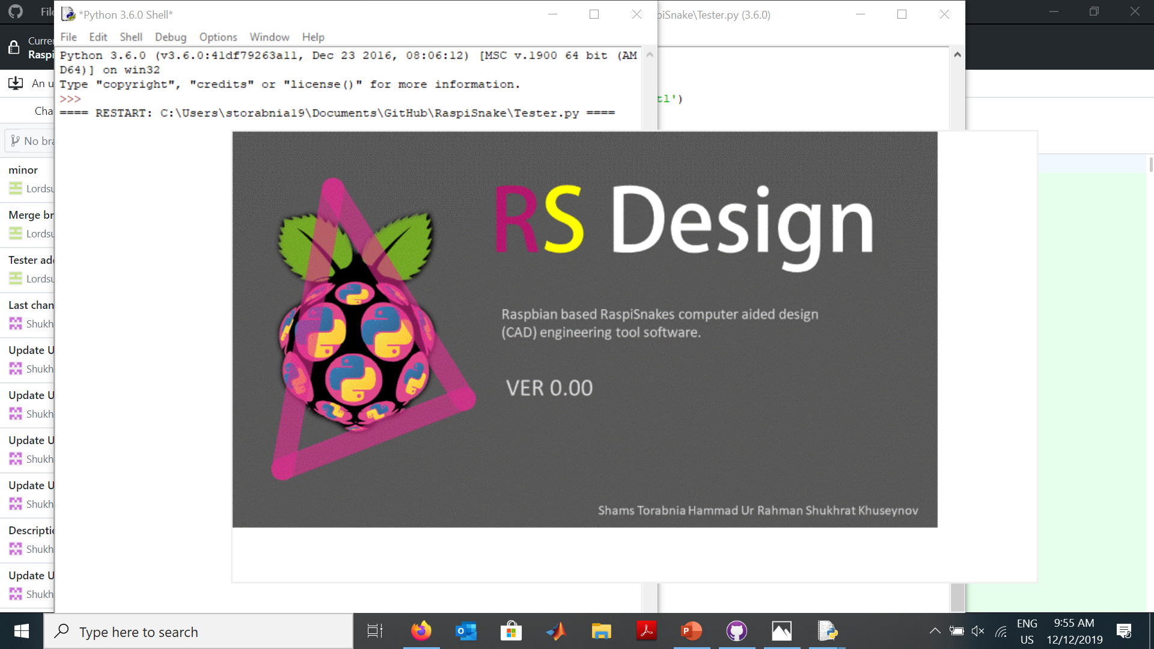
RS Design

Slide 21
Status
Issues
Page file is become big restarting environment needed
Achievements
Basic modules
Easy to render
Simple graphical environment
Plotter is not interactive

Slide 22
Further Developments
Making Git Public
Adding more formats
Using an interactive plotter
Mesh toolbar
Path toolbar

Slide 23
RS Design
Raspbian based RaspiSnakes computer aided design (CAD) engineering tool software.
Tank You ☺

